Slide 1


Legacies Screen Printers
XISD FINAL POE

Slide 2
Problem Statement What is wrong with Legacies Screen Printers?
Our system separates the owner's personal life from business affairs.
Allowing users to automatically upload vinyl designs.
Automatic calculations of project prices.
Has dashboard alerts to say when stock is low.
Reducing mistakes and never getting orders mixed.
Processing orders are quicker
Keep things organised and prevent dara lose.
Without the system it will lead to incorrect records of stock levels, Delayed production and difficulty finding user information.
Manually records orders
Orders placed over calls
Uses personal devices
Business lacks automatic equipment
Requires an ordering system
Emails tracks transactions
Lacks proper was to store and keep customer data safe
Laser cutter design is picked manually.
Delayed production for big projects
Printing is done manually

Slide 3
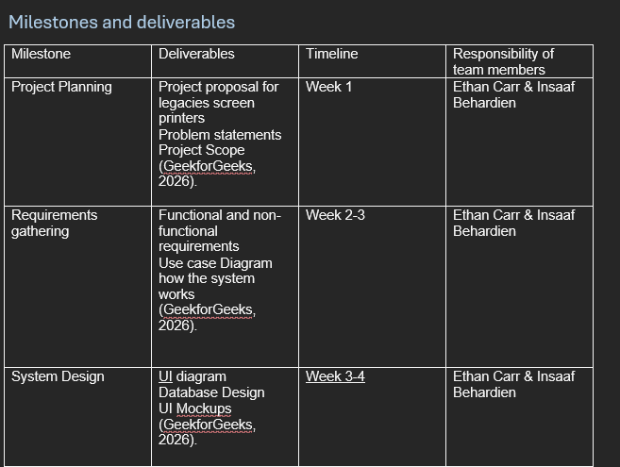
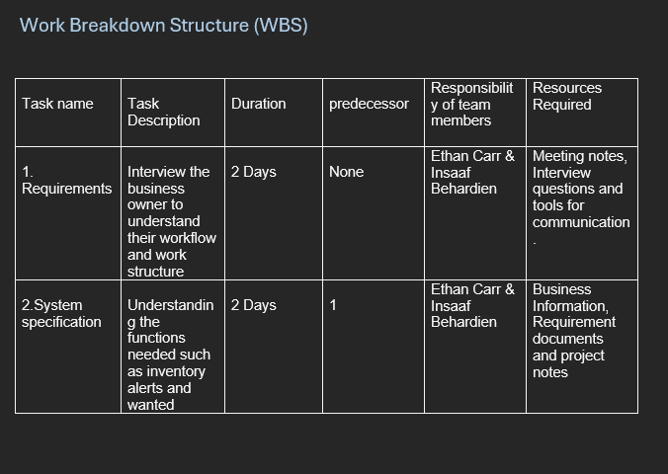
Project WBS, Milestones and Budget
Project Budget
Total time for Estimated development: 336 Hours Developer Tariff: R250 per Hour
The Total Estimated Cost for the Project: R84 000
Milestones:
Planning & requirements
System design (UI, database, architecture)
Development of prototype
Testing and improvements
Final presentation/submission
WBS
Requirements → Identify business needs and system functions
Design → Create UI, database and architecture
Development → Build front-end, back-end and database
Testing → Validate system functionality and fix issues
Documentation → Prepare final submission and presentation
Final Submission

Slide 4
Logical Architectural Design
Client Layer
Server Layer
The customer ordering portal
Customer order tracking
Owner management portal
Inventory management
Processing request
Validating information
Business rules apply
Database:
The database is what stores all the server-side data and stores all system information.
Customer, order, OrderItem, Design, Inventory
The system uses a two-tiered architecture. Client and server/
The server handles all the processing and management a of the database. Its responsible for validating and communicating with the database.
The client server handles user interactions. This mean customers and the owner interacts with the systems features.

Slide 5
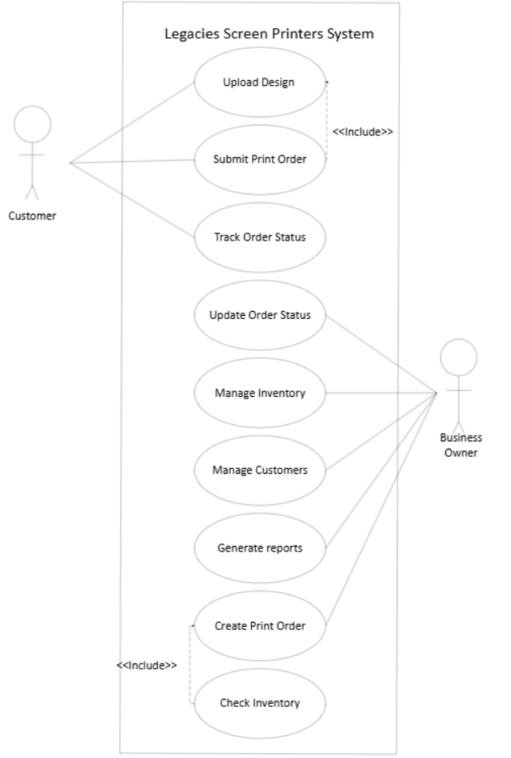
Use Case Diagram
Actors:
Users
Owner
Function:
Place order, upload design and track order.
Manage orders, manage customer details, manage stock.
Inputs:
Customer Details, Design image, customer name and Contactnumber.
Customer details (name, contact, email) Order details change and quantity is incresed.
Systems Actions
Creates order, Links the designs to the OrderID in the OrderItems table and retrieves order status.
Updates order progress, stores customer data, updates stock levels.
Outputs:
Saved order, Design attached to order, progress of order
Updated customer records, updated order status and updated stock records

Slide 6
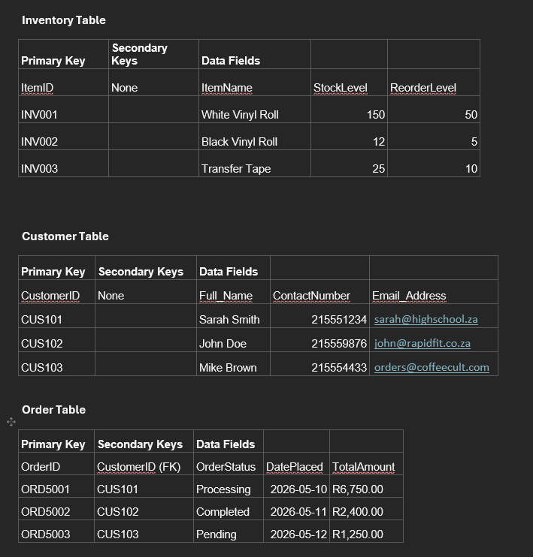
DATABASE SETUP
Our Database is broken down into 5 tables keeping this organised and linked together.
CUSTOMER
ORDER
ORDERITEMS
INVENTORY
DESIGN
All these tables have an important role to play to keep the system together.
Each have their unique primary keys to identify record and a foreign key used to connect related tables.
Ensuring all data types match.
Example:
100 stickers with Design A
100 stickers with Design B
Different datatypes used:
ORDERID – Varchar – PK
CustomerrID – VARCHAR – FK
DatePlaced - Date
TotalAmount – Double
QuantityRequired - Integer

Slide 7
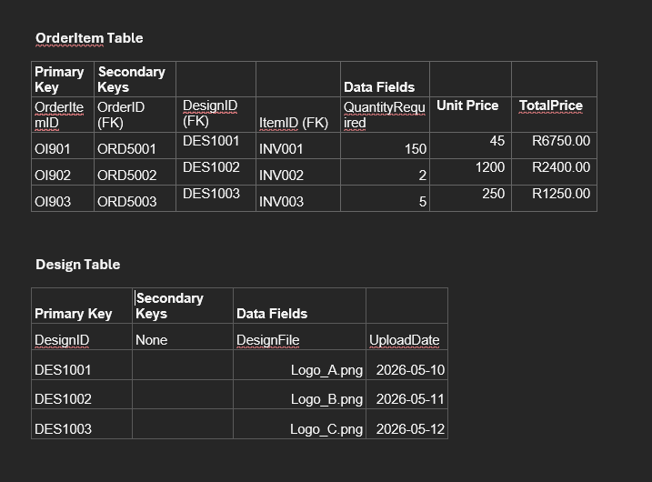
2 Tables have aforeign key that connects them
Order table has a Fk CustomerId that links it to the customer table, telling us who is the customer that placed the order.
OrderItem Table
Contains three Fks
OrderID, DesignID and ItemID.
This connecting it to all 3 tables Order, Design and Inventory.
Letting the system know which order it belongs to, what design needs to be printed and which vinyl from the inventory to use.

Slide 8
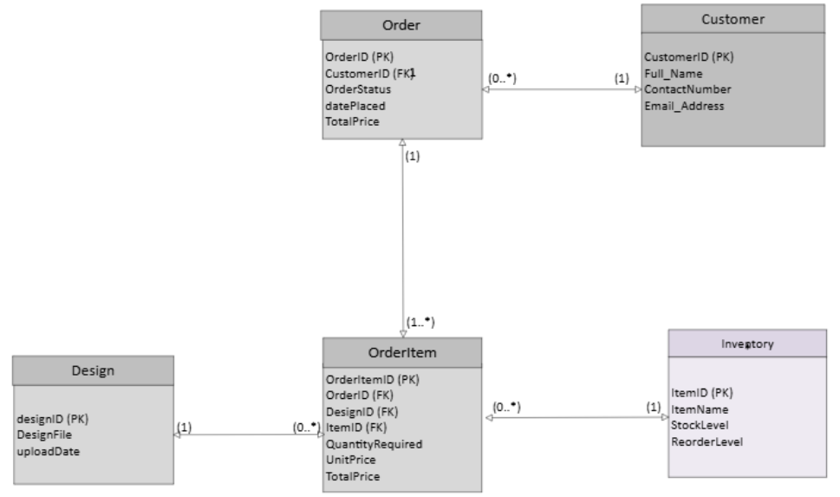
ERD DIGRAM / RELATIONSHIPS The Building Blocks to the system

Slide 9
ERD /Relationships
In our system the most important relationship is the between Order and OrderItem. WHY?
Who? Customer
What was requested? Order
The finer Details? OrderItems
Because one order can have different items, designs and quantitie OrderItem stores the separetly, preventing duplicate data in Order.
The ERD diagram is used to show the relationships between entities in a database and how many record from one table can relate to other records in another table this is cardinality.
Entities = Tables
Customer
Attributes = Information in each table
CustomerID
Relationships are how the tables connect and cardinality is how much records can connect between the tables.
Without relationships tables can't connect, Foreign keys help connect the tables. Customer places an order and what items belong to that order.
Examples of cardinality:
Customer -> Order
Customer 1 ------ 0..* Order
This means one customer can have
No orders
One order
many orders.
But 1 order can only have 1 customer

Slide 10
Example of why OrderItem is an important table
100 stickers with Design A
100 stickers with Design B
Order
ORD5001 LOGO A 100
ORD5001 LOGO B 100
It cant work. There will be a duplicate entry of the order number, the order number cant be different either because then nothing leads the order back to each other
100 stickers with Design A
100 stickers with Design B
OrderItem
OI5001 ORD5001 LOGO A 100
OI5001 ORD5001 LOGO B 100
It works because the Items can still be separated but come from the same order. In order having duplicates would be very messy.

Slide 11
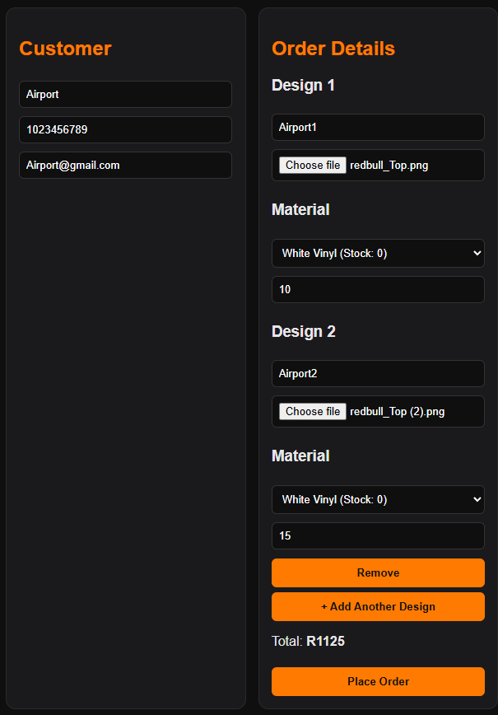
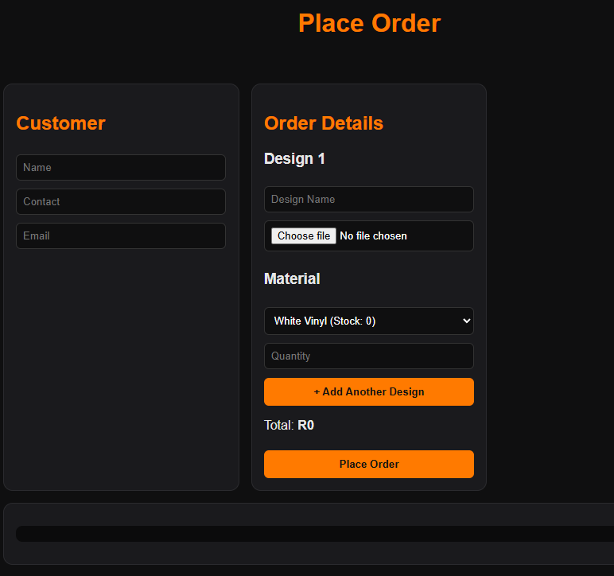
Live prototype Customer Portal
Order Placed gives customer details at the bottom
Customer order
Customer Enters information to place their order. Information entered will be the source to help keep track of their order

Slide 12
Why was User Order Entry Important?
It allows users to enter their own information and places their orders. Legacies Screen printers was manually entering order data onto paper, this was inefficient and time consuming. The system now reduces the time taken doing manual entries.
Designs are uploaded to order references
This means that every design is connected to an order id, because of that, it makes it easier for the laser cutter to identify the design needed. The owner will no longer need to assign the design manually.
It's makes everything easier for the owner, because everything is done automatically such as calculation, entry of users into the system, design upload. All the owner has to do is print the orders.

Slide 13
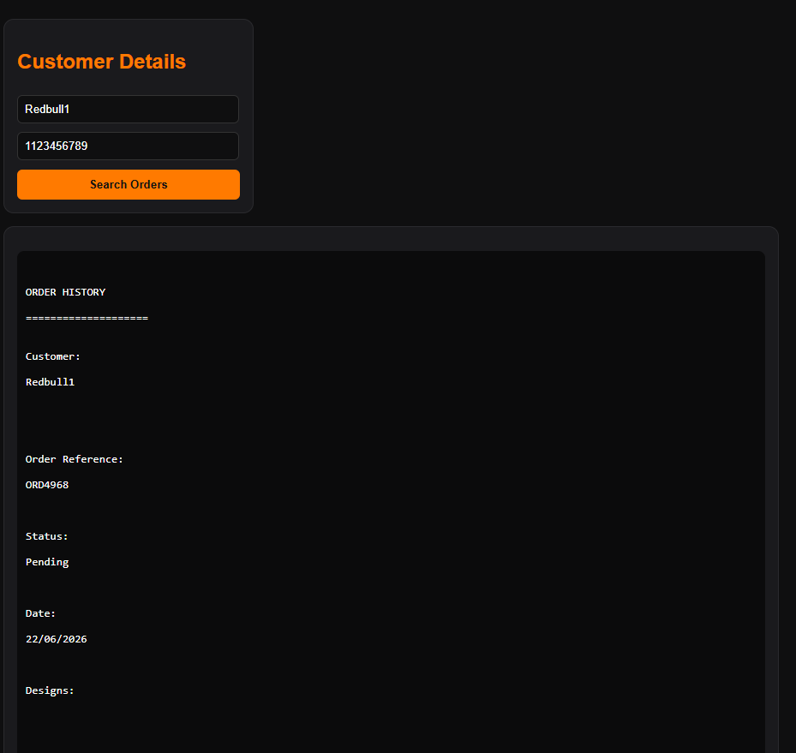
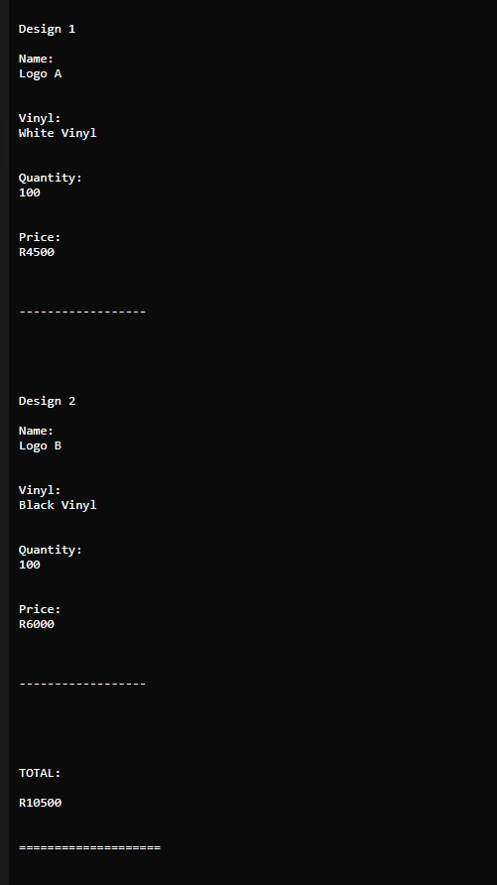
The Example of 2 Designs 1 entry

Slide 14
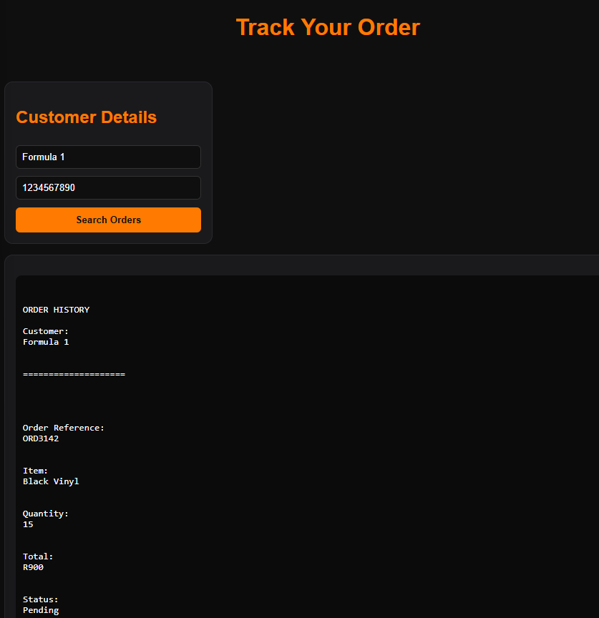
Customer Order Tracking
Orders placed by customers can be tracked by entering user information.
Enter Name and Contact number.
All Order history linked to the customer details entered will be displayed below.
WHY?
So that users can keep track of order progress, which get updated by the owner. This making it easier for the owner to keep customers informed on the progress of their order.
Allows users to access their order information and shows that the users data is being keep on the system.
Reduces loss of user data
Make their data available to the users
Gives a live update so the owner doesn’t have to email or call to inform them about the updates

Slide 15
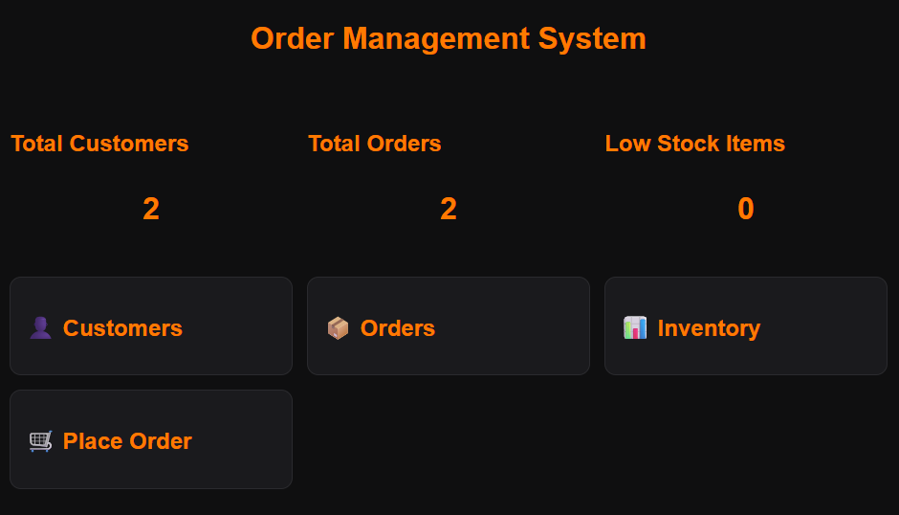
Owner's management portal
Navigation menus, panels and business information
This area consist of navigations for the owners portal.
Allows users to view Total Customers, orders and if stock is low.
Makes it easy to navigate to different pages
Main dashboard can lead the owner to any of the 3 different pages.

Slide 16
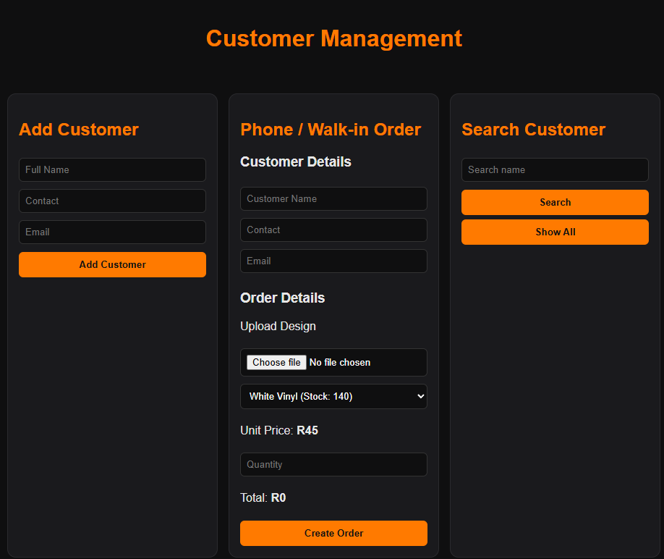
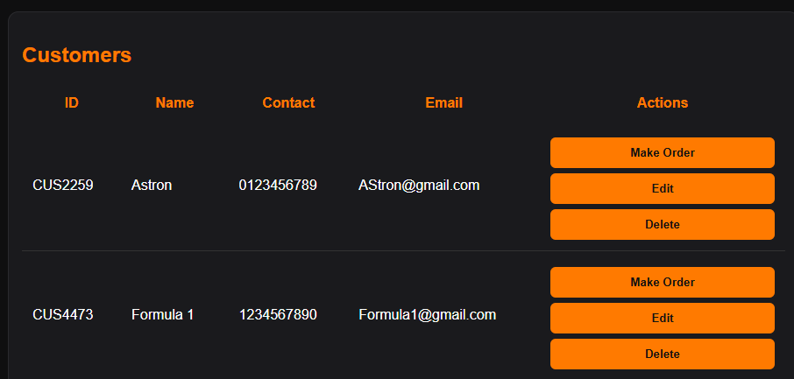
Managing Customer information
Shows immediate calculation of customers order requests.
Allows owner to upload customer detail then add and order or store customer details for future orders.
Owner can edit and delete customer.
Search is available to look for specific contacts.
The owner can add customer orders from phone calls or walk-ins. Customers added can have an order be made without having a double entry of their details.

Slide 17
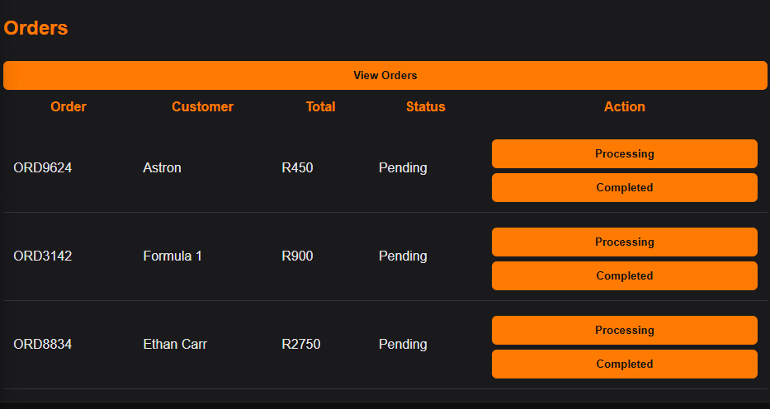
Order History
This keeps track of the orders placed by customers where the owner can update order status, changing it from pending to processing and the final option the order being complete.

Slide 18
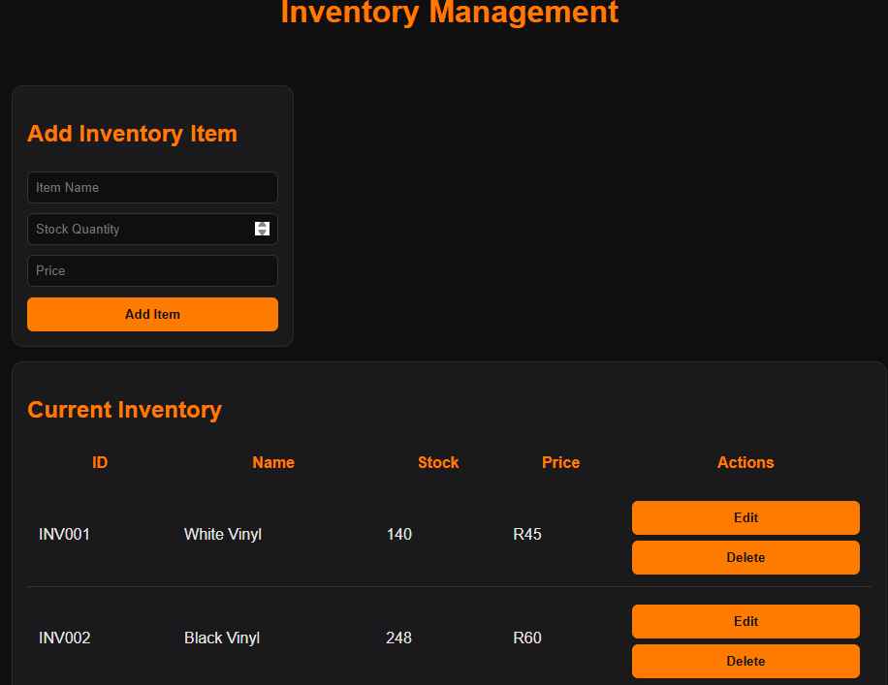
Inventory
Inventory management is used by the owner to add new vinyl, update stock levels, remove a vinyl item and change its prices.
Every order that occurs the stock visually decreases.
Makes it convenient and easy to keep track of stock.

Slide 19
Conclusion
This system is built to help Legacies screen printers to replace the manual process with a digital system. The system allows customers to enter their own details, upload designs, track order and place orders. Thus making it much easier for the owner to get printing done, and separating personal life work affairs.

